Slide 1
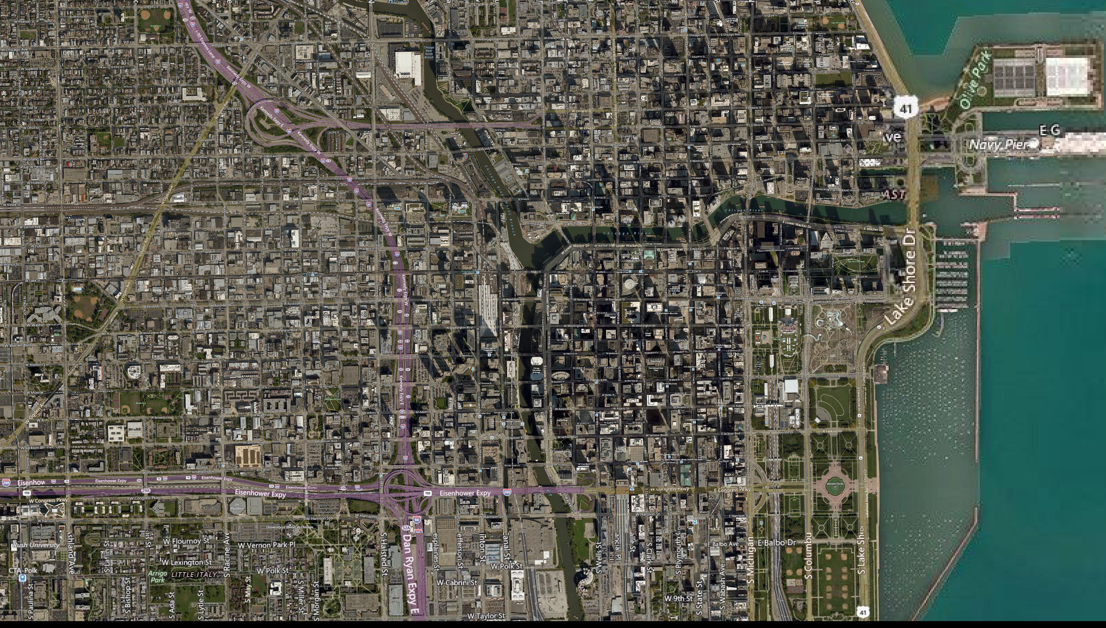
Aerial/Satellite Imagery Retrieval
EECS 495 HW3
Yuqi Zhao
Fan Liu
Shirui Xu

Slide 2
Purpose of the program
This program is developed to download the an aerial image from Bing Map with the best resolution.
Showing a Bounding Box for the interested Area.

Slide 3
Resources
Bing Maps Tile System Documentation
Provide basic idea and API for retrieving satellite image for Bing Map Server
Offer basic functions for developer
Most of the functionality is provided by Microsoft in their Bing_Tilt_System,we are using the python version of it from github.

Slide 4
Image Retrieval Steps
(1)Compute the lowest level of detail that we have at most a 2 x 2 tiles area
(2)Starting from the lowest level of detail to download each tiles from Bing map to form the most blurring image of the region
(3) Then we increase the level of detail by 1 and half the tile size then we get 4 times more tiles from Bing map to form a image with more detail
(4) Then repeat the step (3) until the size of tile reached the minimum size
(5) Identify the position of the exact starting point and ending point in the image and draw a reference line.

Slide 5
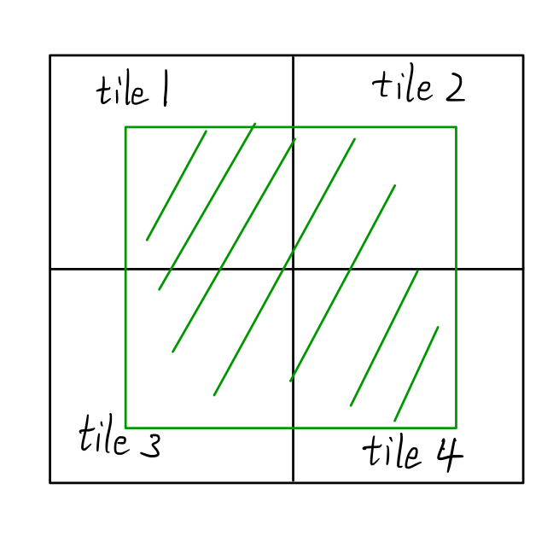
Step (1):Initialization
Building up the framework of the mapping area (framework×framework) and the minimum size of the tile (ministemp×ministemp)
Transfer the longitude and latitude of the 2 diagonal points of the region we want to tile numbers (x and y) in different level of details (from 23 to 1). If the difference of tile numbers of two points are both not larger than 1. Then we get the lowest level of detail.
The area of Interest will take ¼ of the image area in the worst condition

Slide 6
Step (2): download image
For each tile in the region, get quadkey of the tile and download an image from the Bing map according to the quadkey.
Then we judge the image we get vacant or not. If not, we resize the image we download and paste it to the location of the tile in the image we initialized.

Slide 7
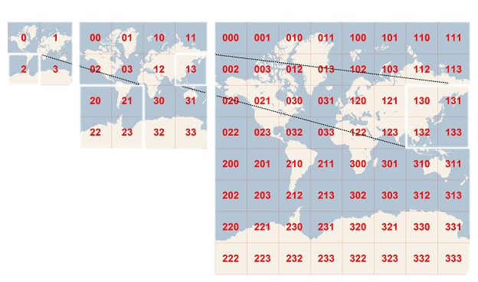
Step(3)&(4): Download image
Increase the level of detail by 1 and decrease the width and length of the tile size to a half.
Download the image of tiles following the instruction in step(2)
Repeat the two steps above until the tile size reaches the minimum size of the tile or reaches the maximum level of detail 23.
Then store the image we get to a .jpeg file.

Slide 8
Step(5): Adding Reference line for Area of Interest
The retrieved image will contain more than just our interested area, so we show 4 reference line for users to identify the boundary of the area.
Calculate the corresponding pixel position of the starting and ending point in the framework image.
Draw a box of the interested area with pixel editing.

Slide 9
Problems and Solutions
Users will not always input the upper left point first and lower right point then, so we need a function to transfer the input into the format we want.
Sometimes we can’t retrieve image due to connection failure and access denial, then the program will print a sentence Bing connection problem and return the best quality image we got.
Low accuracy of positioning in some part of the World. We can’t get the right image for examples in China due to low accuracy of positioning. Trying to Search for a bigger area to make sure the target is in the image.
Users can’t tell the exact point they inputted, so we add reference line to outline the boundary of the area.
Some users forget to input parameter for the script and we add a default value of the United States Map.

Slide 10
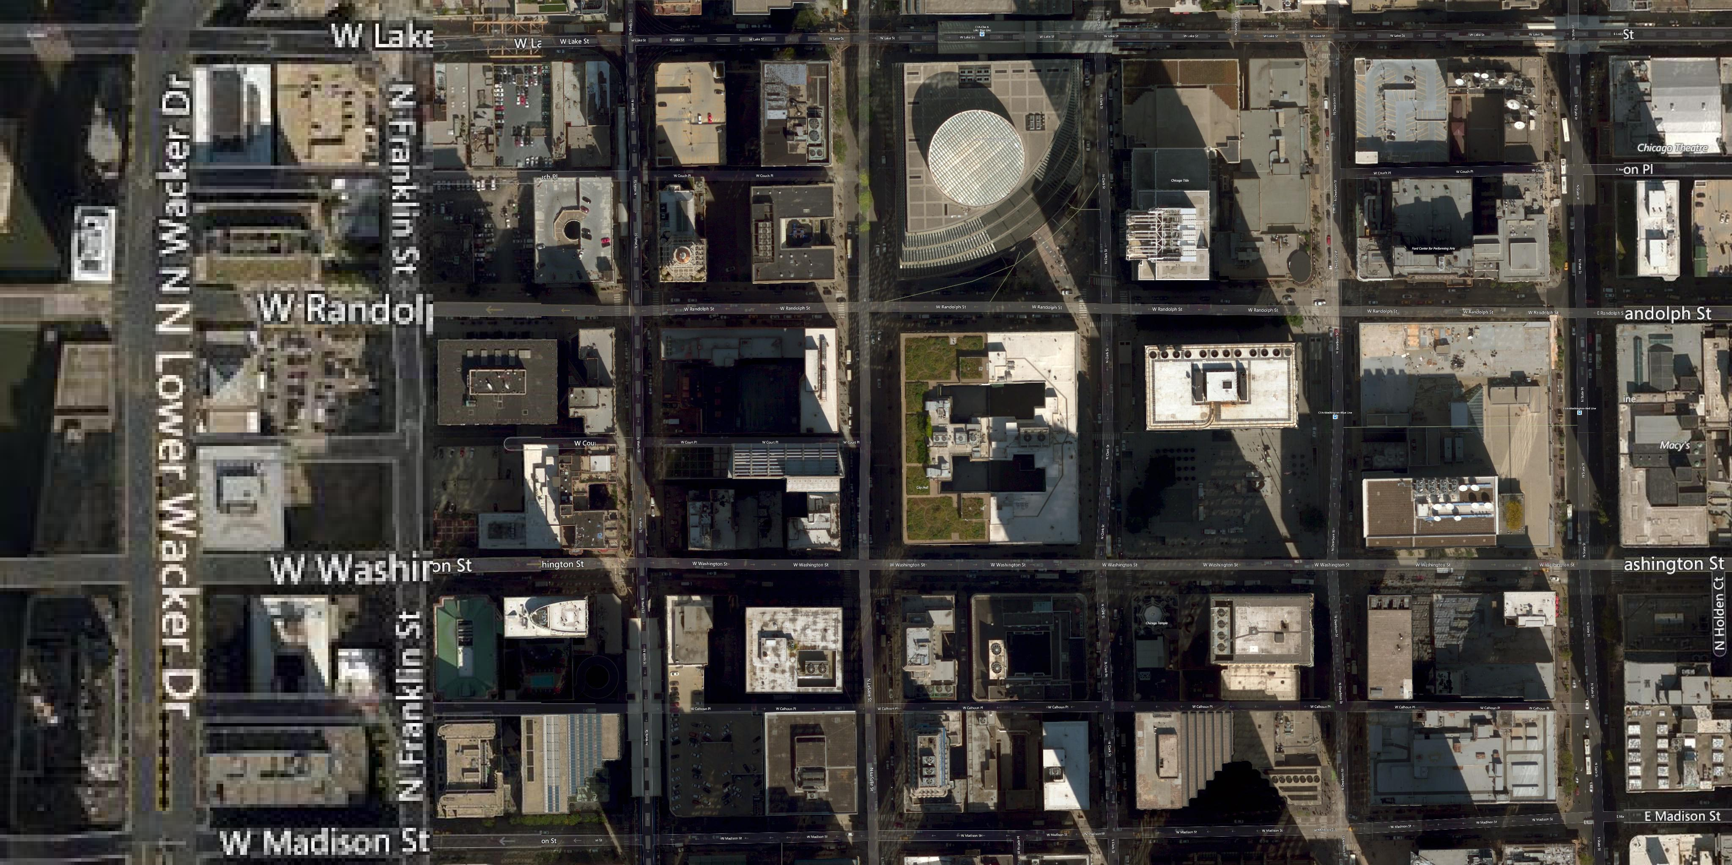
Results

